Slide 1
Presentation Title
Presentation Subtitle
Meta Information

Slide 2
Presentation Title
Presentation Subtitle
Meta Information

Slide 3


Presentation Title
Presentation Subtitle

Slide 4

Presentation Title
Presentation Subtitle

Slide 5
Divider Slide

Slide 6
Divider Slide

Slide 7
Agenda
Agenda Item One Quissequae quia vel is maiosae su
Agenda Item Two Ucimo bero destruptae estiur alitaspid
Agenda Item Three Idereicia idesseq uodios est, quam
Agenda Item Four Con pre, soluptatur, omni odia explam
Agenda Item Five Dus nam, as doloritati officil lecture

Slide 8
One Column Text Slide
Occullorum rem et doluptas evenis ex experer sperum nobit occupta tenissi nulparibus adisitia dolo endae molupta cus ex eosseque parum, et ut qui con comnis molore enda doluptat volumet alitis di alis pro iligenecae doluptur, sum voluptata quam unt quaepudaere ma simodi volorrumet evenderatis et ommodi remodi ipsuntorit di is velluptae.
Eperibusam rem laborio. Del magnimo luptium qui officium assi apita qui velisqui ium
Voles cus aut quis acea inti quas quis aut aut et quis auteturectem velessit faci odi odipsam consectur?
Dolum labore, conectu saperum doluptias adi conser

Slide 9
Two Column Text Slide
Occullorum rem et doluptas
evenis ex experer sperum
nobit occupta tenissi
nulparibus adisitia dolo endae
molupta cus ex eosseque
parum, et ut qui con comnis
molore enda doluptat volumet
alitis di alis pro iligenecae
doluptur, sum voluptata quam
unt quaepudaere ma simodi
volorrumet evenderatis et
ommodi remodi ipsuntorit di is
velluptae.
Eperibusam rem laborio. Del
magnimo luptium qui officium
assi apita qui velisqui ium
voles cus aut quis acea inti
quas quis aut aut et quis
auteturectem velessit faci odi
odipsam consectur?
Dolum labore, conectu
saperum doluptias adi consers

Slide 10
Full Width Text Slide
Occullorum rem et doluptas evenis ex experer sperum nobit occupta tenissi nulparibus adisitia dolo endae
molupta cus ex eosseque parum, et ut qui con comnis molore enda doluptat volumet alitis di alis pro
iligenecae doluptur, sum voluptata quam unt quaepudaere ma simodi volorrumet evenderatis et ommodi
remodi ipsuntorit di is velluptae.
Eperibusam rem laborio. Del magnimo luptium qui officium assi apita qui velisqui ium
Voles cus aut quis acea inti quas quis aut aut et quis auteturectem velessit faci odi odipsam consectur?
Dolum labore, conectu saperum doluptias adi consers

Slide 11
Full Width Two Column Text Slide
Occullorum rem et doluptas evenis ex experer
sperum nobit occupta tenissi nulparibus adisitia dolo
endae molupta cus ex eosseque parum, et ut qui
con comnis molore enda doluptat volumet alitis di
alis pro iligenecae doluptur, sum voluptata quam unt
quaepudaere ma simodi volorrumet evenderatis et
ommodi remodi ipsuntorit di is velluptae. Eperibusam
rem laborio. Del magnimo luptium qui officium assi
apita qui velisqui ium.
Voles cus aut quis acea inti quas quis aut aut et quis
auteturectem velessit faci odi odipsam consectur?
Dolum labore, conectu saperum doluptias adi
consers.Pis re latium vel est la ducia derum, temodic
imoluptae quodias et quod qui sit, es a dem eictotas
doluptat id ut vel is acessus este sequaep uditas

Slide 12

Image and Text Slide
Occullorum rem et doluptas evenis ex experer sperum nobit
occupta tenissi nulparibus adisitia dolo endae molupta cus ex
eosseque parum, et ut qui con comnis molore enda doluptat
volumet alitis di alis pro iligenecae doluptur, sum voluptata
quam unt quaepudaere ma simodi volorrumet evenderatis
et ommodi remodi ipsuntorit di is velluptae. Eperibusam rem
laborio.

Slide 13
Inline Image and Text Slide
Occullorum rem et doluptas evenis ex experer sperum nobit
occupta tenissi nulparibus adisitia dolo endae molupta cus ex
eosseque parum, et ut qui con comnis molore enda doluptat
volumet alitis di alis pro iligenecae doluptur, sum voluptata
quam unt quaepudaere ma simodi volorrumet evenderatis
et ommodi remodi ipsuntorit di is velluptae. Eperibusam rem
laborio.
Image caption text em quid exerum.

Slide 14
Full Width Image Slide
Image caption text em quid exerum de sequame re list latiunt.

Slide 15
Table and Text Slide
Occullorum rem et doluptas evenis ex experer
sperum nobit occupta tenissi nulparibus adisitia
dolo endae molupta cus ex eosseque parum, et ut
qui con comnis molore enda dolupta.
COLUMN HEADING | COLUMN HEADING
Occullorum rem et doluptas evenis ex | Occullorum rem et doluptas evenis ex experer sperum nobit occupta tenissi
Experer sperum nobit occupta tenissi | Occullorum rem et doluptas evenis ex experer sperum nobit occupta tenissi
Sum voluptata quam unt quaepudaere ma | Experer sperum nobit occupta tenissi sum voluptata quam unt quaepudaere ma
Experer sperum nobit occupta tenissi | Occullorum rem et doluptas evenis ex experer sperum nobit occupta tenissi
Occullorum rem et doluptas evenis ex | Occullorum rem et doluptas evenis ex experer sperum nobit occupta tenissi
Experer sperum nobit occupta tenissi | Occullorum rem et doluptas evenis ex experer sperum nobit occupta tenissi

Slide 16

PAGNY Executive Leadership Team
First Name Last Name
First Name Last Name
First Name Last Name
First Name Last Name
Position/Title
Position/Title
Position/Title
Position/Title
First Name Last Name
Position/Title
First Name Last Name
First Name Last Name
First Name Last Name
First Name Last Name
Position/Title
Position/Title
Position/Title
Position/Title

Slide 17
PAGNY Board of Directors
First Name Last Name
First Name Last Name
First Name Last Name
First Name Last Name
First Name Last Name
First Name Last Name
Position/Title
Position/Title
Position/Title
Position/Title
Position/Title
Position/Title
First Name Last Name
First Name Last Name
First Name Last Name
First Name Last Name
First Name Last Name
First Name Last Name
Position/Title
Position/Title
Position/Title
Position/Title
Position/Title
Position/Title

Slide 18
PAGNY Board of Directors cont.
First Name Last Name
First Name Last Name
First Name Last Name
First Name Last Name
Position/Title
Position/Title
Position/Title
Position/Title
First Name Last Name
First Name Last Name
First Name Last Name
First Name Last Name
Position/Title
Position/Title
Position/Title
Position/Title

Slide 19
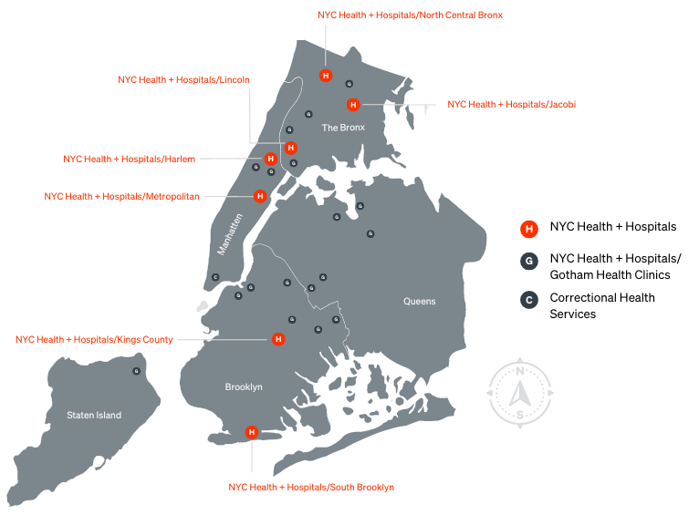
PAGNY Locations
Occullorum rem et doluptas evenis ex experer
sperum nobit occupta tenissi nulparibus adisitia
dolo endae molupta cus ex eosseque parum, et ut
qui con comnis molore enda dolupta.

Slide 20
Flowchart Slide
Inputs bi-weekly timesheets
Completes and submits
timesheets by end of Friday
before payroll processing week
Paycheck/Direct Deposit
received on the following Friday
Employee
Reviews and edits employee
timesheets
Approves timesheets by 12pm
on Monday of payroll processing
week
Paycheck/Direct Deposit
received on Friday
SUPERVISOR/CHIEF

Slide 21
This a Timeline Slide
Q1 2022
Idic tempedita quo
dolorehendus mosa Tem
sequis et
Q3 2022
Idic tempedita quo
dolorehendus mosa Tem
sequis et
Q1 2023
Idic tempedita quo
dolorehendus mosa Tem
sequis et
Q3 2023
Idic tempedita quo
dolorehendus mosa Tem
sequis et
Q2 2022
Idic tempedita quo
Dolorehendus mosa Tem
sequis et
Q4 2022
Idic tempedita quo
dolorehendus mosa Tem
sequis et
Q2 2023
Idic tempedita quo
dolorehendus mosa Tem
sequis et

Slide 22
Typography Hierarchy
These are bullets, level one
Ro experios magnimp erionsequo et qui at la nat aut volloratur
These are sub-bullets level two
These are sub-bullets level three
Cusdam id quate eati aut que perferro earum que
These are sub-bullets level four, pre optatquae ipsum remporehent ium que simolum est
Quat qui dis doluptam
This is a heading
This is a smaller heading
This is large body text, usdam id quate eati aut que
perferro earum que pre optatquae ipsum rempore-hent ium que simolum est, quat qui dis doluptam.
This is small body text. Ro experios magnimp erionsequo et qui at
la nat aut volloratur.
These are numbered bullets.
Ro experios magnimp erionsequo et.
Cusdam id quate eati aut que perferro earum que pre optatquae ipsum remporehent ium que simolum est, quat qui dis doluptam.
This is footnote and captions text.
THIS IS THE FOOTER TEXT AND SOURCE TEXT

Slide 23
Template Guidelines
The PAGNY PowerPoint Template
This PowerPoint presentation is a template with a custom palette, master layouts and pre-formatted slide content.
Use this template to create screen and print presentations.
If desired, save this files as a “.potx” template file.
Fonts
This template requires the following fonts which are installed with all versions of PowerPoint:
Franklin Gothic Book
Franklin Gothic Demi
To Create a New Presentation
Open and resave this file with your own filename by selecting “Save As” from the File menu.
To Create New Slides
Duplicate and revise the pre-formatted slides as needed. Delete slides that are not needed.
Alternatively, create new slides by selecting “New Slide” from the Insert menu, and choosing a Slide Layout. Some slides however, such as Title Slides 3 & 4, and the Table, Flowchart and Timeline, must be created by duplicating the pre-formatted sample slides.
Text Formatting
Highlight and type over existing text to revise it.
When pasting text into a pre-formatted text block, use "Paste Special / Unformatted Text" or “Keep Text Only” to prevent pasting unwanted source formatting along with the text.
Tip: Enter a space in a text placeholder to make it appear “invisible” while saving it for later.
Placing Images
For best practices and to control the file size for images and graphics, use Photoshop or other software to adjust these assets before placing them onto slides.
To replace an existing image, right-click on it and select “Change Picture”.
To place a new image after inserting a new slide with an image Layout, click the insert icon in the center of the picture placeholder.
To Edit the “PRESENTATION NAME” in the Footer
Take care not to inadvertently nudge objects out of position while working on the Slide Master and Layouts. Save an unedited copy of the Template for reference, in case you ever need to retrieve object positions and formatting.
Edit the presentation footer on the very first Slide Master, labeled “PAGNY Slide Master”:
From the View menu, select “Slide Master”.
In the Navigation Window at the left-side of the screen, scroll up to the very first Slide Master, labeled “PAGNY Slide Master”. Click on it to select it.
Edit the “PRESENTATION NAME” footer text on that Master. All slides with the standard footer will show the edits made.
When finished, select "Close Master View" from the Slide Master menu.
Printing in Black and White
Select “Print” from PowerPoint’s File menu and select the “Color” setting even when printing to a Black and White printer. A known bug will cause artifacts such as borders around text boxes when “Grayscale” or “Pure Black and White” are selected.

